Slide 1
Alternative Testing Arrangements
2025

Slide 2
Alternative Testing Arrangements
What: Alteration of standard testing conditions, procedures,
and/or materials
Why: American with Disabilities Act (ADA) – and validity
How: Submissions handled on a case-by-case basis
Copyright © 2025 Pearson Education, Inc. or its affiliates. All rights reserved.

Slide 3
Process for Requesting Arrangements
1
Review
“Documentation Requirements”
and collect necessary documents.**
2
Register for the test.
Declare intent to request alternative testing arrangements.
4
Submit Alternative Testing Arrangements Request Form with each registration.
3
DO NOT schedule test appointment yet.
5
Check email for notification of resolution. Resolution is typically within three weeks.
Check spam folder.
6
Follow instructions provided in the resolution email to schedule appointment.
** Documentation is submitted with first request only unless there is a change in the condition or the arrangements requested.

Slide 4



Alternative Testing Arrangements
Website
Informational video
Candidate Support
Alternative Testing Arrangements
Requesting Accommodations (vimeo.com): including ASL and transcript
Alternative Testing Arrangements
Copyright © 2025 Pearson Education, Inc. or its affiliates. All rights reserved.

Slide 5
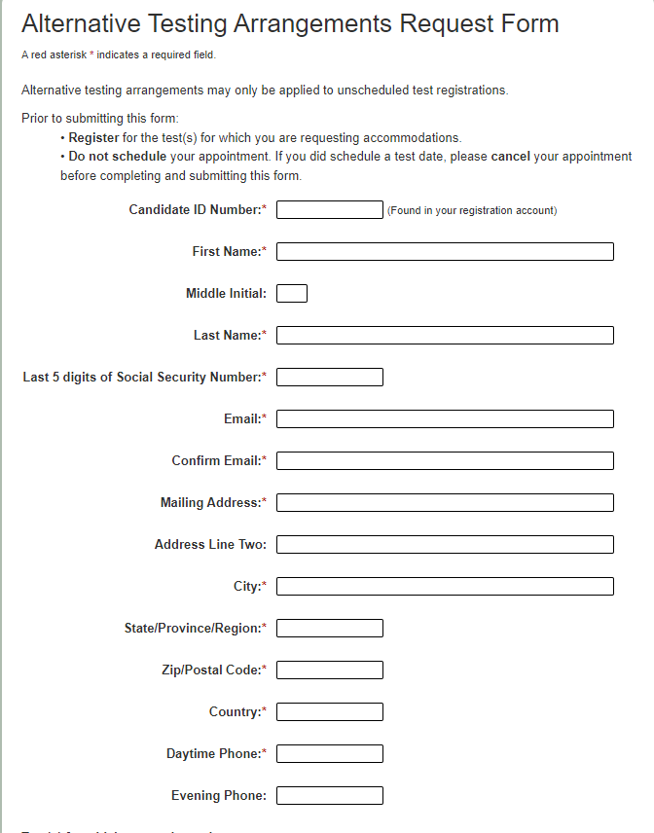
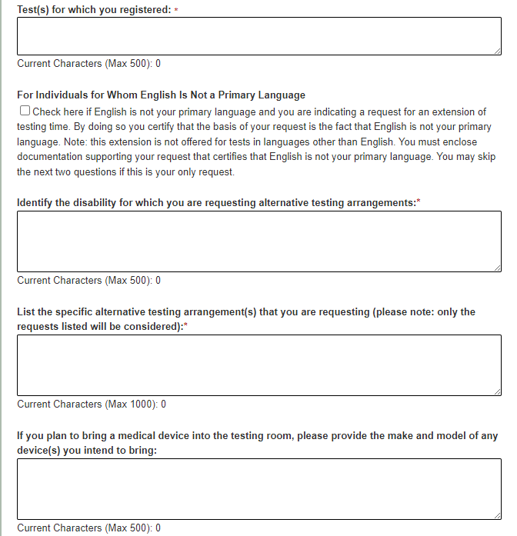
Alternative Testing Arrangements Request Form
5

Slide 6
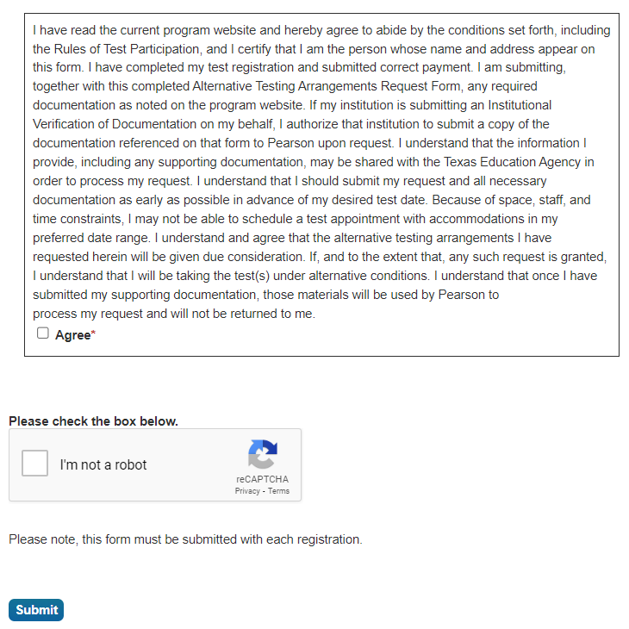
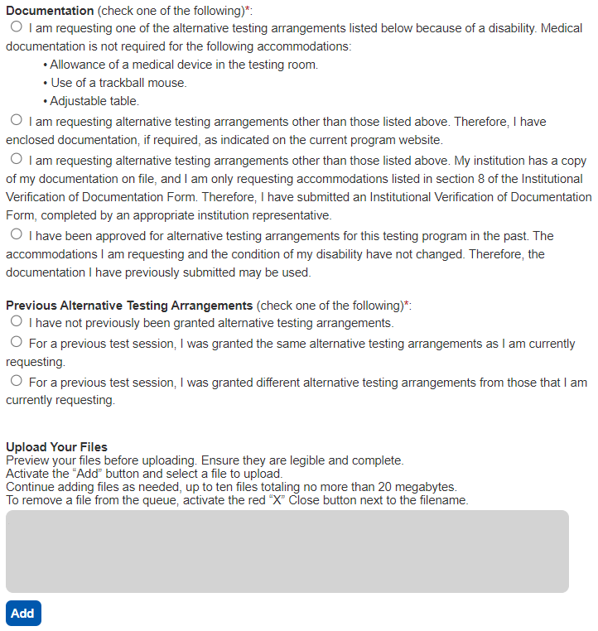
Alternative Testing Arrangements Request Form
If for extra time, this approval is automatic.

Slide 7
Institutional Verification
Applies to:
  50% extra time
  ASL interpreter for communication with test center staff
  Braille test format
  Screen magnification software greater than 200%
Link to form: Institutional Verification of Documentation
Copyright © 2024 Pearson Education, Inc. or its affiliates. All rights reserved.

Slide 8
Next Steps
Completed Application
Follow steps In your resolution email.
Schedule appointment to test
Incomplete Application
More documentation is needed to review
Does not mean application is denied
Denied ApplicatIon
Formal outlined process
Appeal should include documentation requested

Slide 9
Appealing a Denied Request
The appeal should include the following information:
Name, address, and candidate ID number
The date of the appeal
Any documentation, in addition to the documentation that you submitted with your Alternative Testing Arrangements Request Form
A brief summary of the reasons why your alternative testing arrangements requests should be granted
Your signature

Slide 10
Online Proctoring
Select tests in the MTEL program are available for online proctoring.
Online proctoring allows you to take your test securely from your home, school, or business.
Online proctoring will be available for each test for a one-week window each month.
Certain MTEL tests may not be offered via online proctoring and will continue to be available via computer-based testing only.
  Tests that require the use of a scanner and tests that include an audio component cannot be administered via online proctoring.

Slide 11
Frequently Asked Questions
General Information
Questions about Documentation
After Initial Approval and Testing

Slide 12
Q & A
Es-mtel@pearson.com

